Slide 1
Object Oriented Programming

Slide 2
Today Topics
Constructor and Destructor without Inheritance
Constructor and Destructor in Single, Multi-level, Multiple, and Hybrid Inheritance
Constructor in Single Inheritance with arguments
Constructor in Multiple Inheritance with arguments
Constructor in Multilevel Inheritance with arguments

Slide 3
Constructor and Destructor without Inheritance (Source.cpp)
#include<iostream>
#include "Header.h"
using namespace std;
int main()
{
{
student obj1, obj2, obj3, obj4, obj5;
}
system("pause");
}

Slide 4
Constructor and Destructor without Inheritance (Header.h)
#include<iostream>
#include "Header.h"
using namespace std;
int main()
{
{
student obj1, obj2, obj3, obj4, obj5;
}
system("pause");
}

Slide 5
Constructor and Destructor without Inheritance (Source1.cpp)
#include "Header.h"
#include <iostream>
using namespace std;
student::student()
{
cout << " Constructor Executed " << endl;
}
student::~student()
{
cout << " De Constructor Executed " << endl;
}

Slide 6
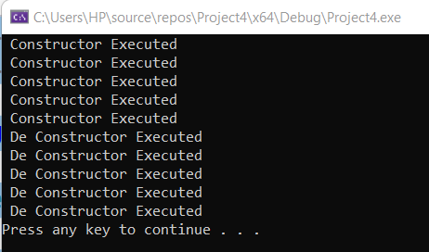
Output

Slide 7
Constructor and Destructor in Single Inheritance
When we are using the constructors and destructors in the inheritance, parent class constructors and destructors are accessible to the child class
Hence when we create an object for the child class, constructors and destructors of both the parent and child classes get executed

Slide 8
Constructor and Destructor in Single Inheritance
In single inheritance, parent class constructors are first called, and then the child class constructors are called.
Destructors are called in the reverse order of constructor calls. So, a derived class destructor is called before its base class destructor

Slide 10
Constructor and Destructor in Single Inheritance (Source.cpp)
#include<iostream>
#include "Header.h"
using namespace std;
int main()
{
{
cout << " Constructor: " << endl;
student obj1;
cout << " Deconstructor: " << endl;
}
system("pause");
}

Slide 11
Constructor and Destructor in Single Inheritance (Header.h)
#pragma once
class person {
private:
int number;
public:
person();
~person();
};
class student:public person {
private:
int roll_no;
public:
student();
~student();
};

Slide 12
Constructor and Destructor in Single Inheritance (Source1.cpp)
student::student()
{
cout << " Derived Class Student Constructor Executed " << endl;
}
student::~student()
{
cout << " Derived Class Student Deconstructor Executed " << endl;
}
#include "Header.h"
#include <iostream>
using namespace std;
person::person()
{
cout << " Object Base Class Person Constructor Executed " << endl;
}
person::~person()
{
cout << " Base Class Deconstructor Executed " << endl;
}

Slide 13
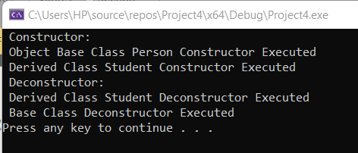
Output

Slide 14
Class Activity
Write a program to understand the concept of constructor and destructor in single inheritance, multi-level, multiple, and hybrid inheritance

Slide 15
Constructor and Destructor in Multi-level Inheritance

Slide 16
Constructor and Destructor in Multi-level Inheritance (Source.cpp)
#include<iostream>
#include "Header.h"
using namespace std;
int main()
{
{
cout << " Constructor: " << endl;
E obj1;
cout << " Deconstructor: " << endl;
}
system("pause");
}

Slide 17
Constructor and Destructor in Multi-level Inheritance (Header.h)
class C :public B {
private:
int c_variable;
public:
C();
~C();
};
class D : public C {
private:
int d_variable;
public:
D();
~D();
};
#pragma once
class A{
private:
int a_variable;
public:
A();
~A();
};
class B:public A {
private:
int b_variable;
public:
B();
~B();
};
class E : public D {
private:
int e_variable;
public:
E();
~E();
};

Slide 18
Constructor and Destructor in Multi-level Inheritance (Source1.cpp)
#include "Header.h"
#include <iostream>
using namespace std;
A::A()
{
cout << " Class A Constructor Executed " << endl;
}
A::~A()
{
cout << " Class A Deconstructor Executed " << endl;
}
B::B()
{
cout << " Class B Constructor Executed " << endl;
}
B::~B()
{
cout << " Class B Deconstructor Executed " << endl;
}
C::C()
{
cout << " Class C Constructor Executed " << endl;
}
C::~C()
{
cout << " Class C Deconstructor Executed " << endl;
}
D::D()
{
cout << " Class D Constructor Executed " << endl;
}
D::~D()
{
cout << " Class D Deconstructor Executed " << endl;
}
E::E()
{
cout << " Class E Constructor Executed " << endl;
}
E::~E()
{
cout << " Class E Deconstructor Executed " << endl;
}

Slide 19
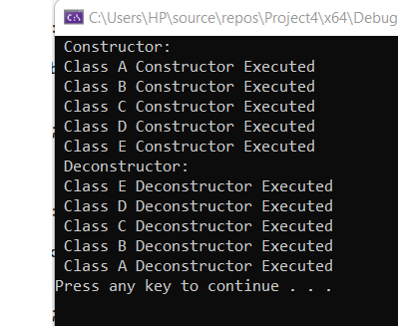
Output

Slide 20
Constructor and Destructor in Multiple Inheritance

Slide 21
Constructor and Destructor in Multiple Inheritance (Source.cpp)
#include<iostream>
#include "Header.h"
using namespace std;
int main()
{
{
cout << " Constructor: " << endl;
E obj1;
cout << " Deconstructor: " << endl;
}
system("pause");
}

Slide 22
Constructor and Destructor in Multi-level Inheritance (Header.h)
class C{
private:
int c_variable;
public:
C();
~C();
};
class D{
private:
int d_variable;
public:
D();
~D();
};
#pragma once
class A{
private:
int a_variable;
public:
A();
~A();
};
class B{
private:
int b_variable;
public:
B();
~B();
};
class E : public D, public A, public C, public B {
private:
int e_variable;
public:
E();
~E();
};

Slide 23
Constructor and Destructor in Multi-level Inheritance (Source1.cpp)
#include "Header.h"
#include <iostream>
using namespace std;
A::A()
{
cout << " Class A Constructor Executed " << endl;
}
A::~A()
{
cout << " Class A Deconstructor Executed " << endl;
}
B::B()
{
cout << " Class B Constructor Executed " << endl;
}
B::~B()
{
cout << " Class B Deconstructor Executed " << endl;
}
C::C()
{
cout << " Class C Constructor Executed " << endl;
}
C::~C()
{
cout << " Class C Deconstructor Executed " << endl;
}
D::D()
{
cout << " Class D Constructor Executed " << endl;
}
D::~D()
{
cout << " Class D Deconstructor Executed " << endl;
}
E::E()
{
cout << " Class E Constructor Executed " << endl;
}
E::~E()
{
cout << " Class E Deconstructor Executed " << endl;
}

Slide 24
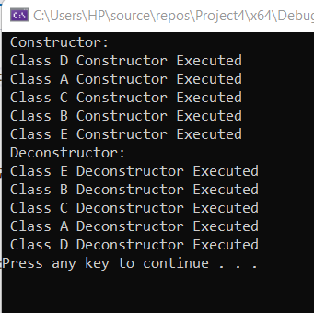
Output

Slide 25
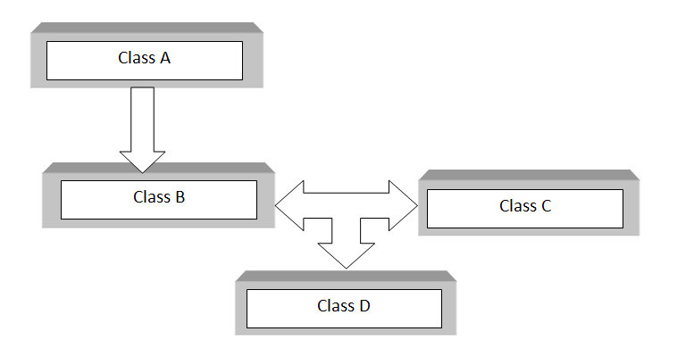
Constructor and Destructor in Hybrid Inheritance
C++ hybrid inheritance is a combination of two or more types of inheritance. It can also be called multi-path inheritance.
Block diagram highlights the concept of hybrid inheritance which involves single and multiple inheritances.

Slide 26
Constructor and Destructor in hybrid Inheritance (Source.cpp)
#include<iostream>
#include "Header.h"
using namespace std;
int main()
{
{
cout << " Constructor: " << endl;
D obj1;
cout << " Deconstructor: " << endl;
}
system("pause");
}

Slide 27
Constructor and Destructor in Hybrid Inheritance (Header.h)
#pragma once
class A {
private:
int a_variable;
public:
A();
~A();
};
class B :public A {
private:
int b_variable;
public:
B();
~B();
};
class C{
private:
int c_variable;
public:
C();
~C();
};
class D : protected B, protected C {
private:
int d_variable;
public:
D();
~D();
};

Slide 28
Constructor and Destructor in Hybrid Inheritance (Source1.cpp)
#include "Header.h"
#include <iostream>
using namespace std;
A::A()
{
cout << " Class A Constructor Executed " << endl;
}
A::~A()
{
cout << " Class A Deconstructor Executed " << endl;
}
B::B()
{
cout << " Class B Constructor Executed " << endl;
}
B::~B()
{
cout << " Class B Deconstructor Executed " << endl;
}
C::C()
{
cout << " Class C Constructor Executed " << endl;
}
C::~C()
{
cout << " Class C Deconstructor Executed " << endl;
}
D::D()
{
cout << " Class D Constructor Executed " << endl;
}
D::~D()
{
cout << " Class D Deconstructor Executed " << endl;
}

Slide 29
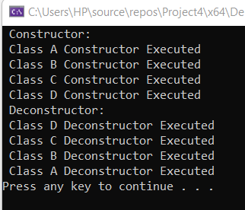
Output

Slide 30
Constructor and Destructor in Single Inheritance with arguments
The derived class is responsible for calling the constructor of the base class.
In the case of the constructor of the base class with arguments, the syntax to define the constructor of the derived class is different.

Slide 31
Constructor and Destructor in Single Inheritance with arguments
The base class constructor is connected with the derived class constructor by using : the header of the derived class constructor.
The parameter of the base class constructor is also given as a parameter list in the derived class constructor.
In a derived class constructor, the parameter of the base class come first than derived class constructor. It is because all data of the base class constructor is initialized before the derived class constructor

Slide 32
Constructor and Destructor in Single Inheritance with arguments (Header.h)
class emp :protected company {
private:
char* namee;
int emp_id;
public:
emp(const char* n, int reg,const char* nn, int id);
void display();
~emp();
};
#pragma once
class company {
protected:
char* name;
int reg_no;
public:
company(const char* n, int reg);
~company();
};

Slide 33
Constructor and Destructor in Single Inheritance with arguments (Source1.cpp)
emp::emp(const char* n, int reg,const char* nn, int id) : company(n, reg) {
int length2 = strlen(nn);
namee = new char[length2];
for (int i = 0; i < length2; i++)
{
namee[i] = nn[i];
}
namee[length2] = '\0';
emp_id = id;
}
void emp::display()
{
cout << " Name of Company: " << name << endl;
cout << " Registration number of company " << reg_no << endl;
cout << " Name of employee: " << namee << endl;
cout << " Name of employee id: " << emp_id << endl;
}
#include "Header.h"
#include<iostream>
using namespace std;
company::company(const char* n, int reg) {
int length = strlen(n);
name = new char[length];
for (int i = 0; i < length; i++)
{
name[i] = n[i];
}
name[length] = '\0';
reg_no = reg;
}
company::~company()
{
cout << " Company Destructor: " << endl;
if (name != NULL)
{
delete[] name;
}
}
emp::~emp()
{
cout << " Employee Destructor: " << endl;
if (namee != NULL)
{
delete[] namee;
}
}

Slide 34
Constructor and Destructor in Single Inheritance with arguments (Source.cpp)
#include<iostream>
#include "Header.h"
using namespace std;
int main()
{
{
char* comp_nme, *emp_nme;
int reg_no, idd;
comp_nme = new char[20];
emp_nme = new char[20];
cout << "Enter Company name: ";
cin.getline(comp_nme, 20);
cout << " Enter Company registration numer: ";
cin >> reg_no;
cout << "Enter Employee name: ";
cin.ignore();
cin.getline(emp_nme, 20);
cout << " Enter Student ID: ";
cin >> idd;
emp obj1(comp_nme, reg_no, emp_nme, idd);
obj1.display();
}
}

Slide 35
Class Activity
Write a program of the calculator to understand the concept of a constructor in multiple inheritances with arguments.

Slide 36
Class Activity
Write a program to understand the concept of a constructor in multilevel inheritances with and without arguments.
Derive a class A with data member x and display value of x with the help of constructor
Derive class B inherited from A and display the value of y with the help of the constructor
Derive class C inherited from B and display the value of z with the help of the constructor
Make an object of class C and assign the value of x, y and z in constructor arguments

